Slide 1


Copyright
We don't have any appealing game series copyright
Overseas Market
The console overseas is a foreign market, so you need to know English well.

Slide 2
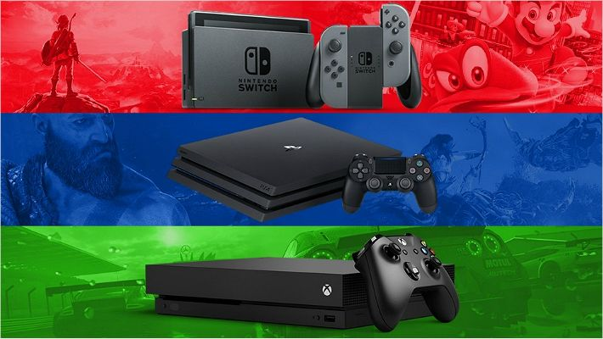


Expensive Price
The price of the console device ranges from $499 to $599, making it difficult to buy it.
Advertising Exposure
Compared to other game markets, the console game market has less exposure to advertising and is difficult to promote.

